Slide 1
Using Corpus Linguistics Tools to Aid Research in the Social Sciences
Mike Scott
Aston University
Friedrich-Alexander University Erlangen, 25 January 2016

Slide 2
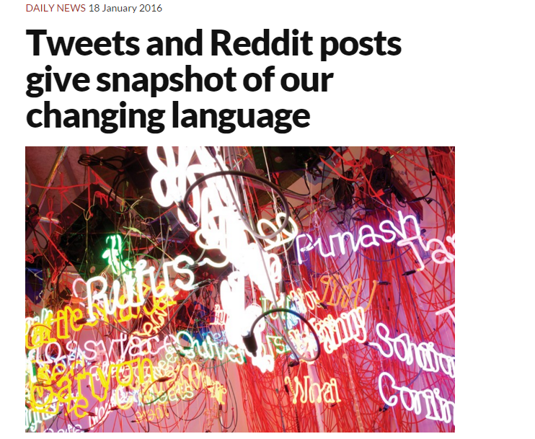

Slide 3
Bootyful, cyw, scrims
Bootyful, cyw, scrims. Do you know these words? If not, you soon might. They are some of the fastest growing words from online niches around the world, as identified by new software that charts the rise of language online.
Bootyful, an alternative spelling for beautiful, has had a dramatic rise in usage on Twitter in South Wales. Cyw (coming your way) has become popular in the north of the country. Scrims comes from gaming forums, where it refers to practice sessions before competitive games.
The software that found these words was developed by Daniel Kershaw and his supervisor, Matthew Rowe, at Lancaster University, UK. Kershaw and Rowe took established methods lexicographers use to chart the popularity of words, translated them into algorithms, then applied them to 22 million words worth of twitter and Reddit posts.
Their goal is to peer into the niche portions of the internet, and chart novel language making its foray out into the mainstream. “If we see an innovation taking off on Reddit or Twitter, the question is what point is it going to appear in a newspaper,” says Rowe.
Kershaw and Rowe’s algorithms don’t just pick out frequently used words, but words that have gone through a sudden rise in popularity. This comes with some complications. The five fastest rising words in central London for the period they studied were all Spanish or Portuguese, unlikely to be reflecting the reality of London’s language scene.
(https://www.newscientist.com/article/dn28787-tweets-and-reddit-posts-give-snapshot-of-our-changing-language)

Slide 4
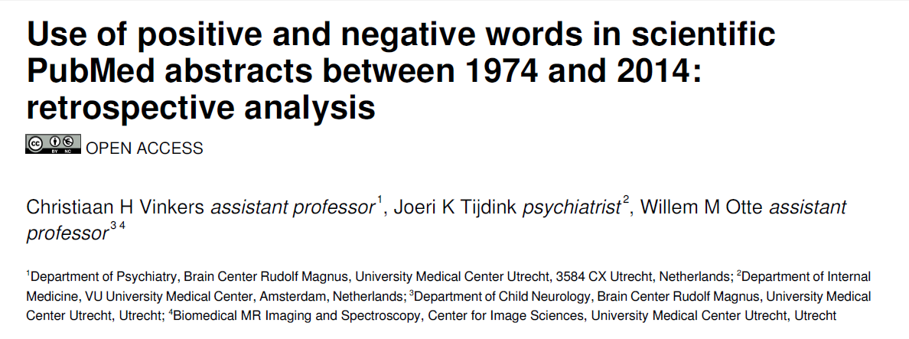

Slide 5
Agenda
Why Corpus Tools?
Which Corpus Tools?
How?

Slide 6
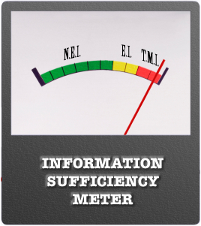
My reason for interest
language teaching
English for Academic Purposes
Latin America
students struggling to understand main points
but getting bogged down in detail

Slide 7
Social Science Research Agenda
Explore events
Understand causes
Understand processes

Slide 8
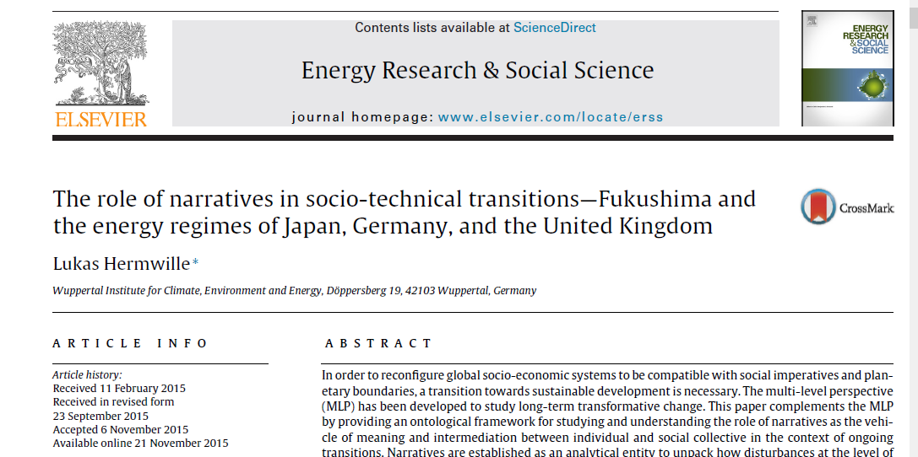

Slide 9
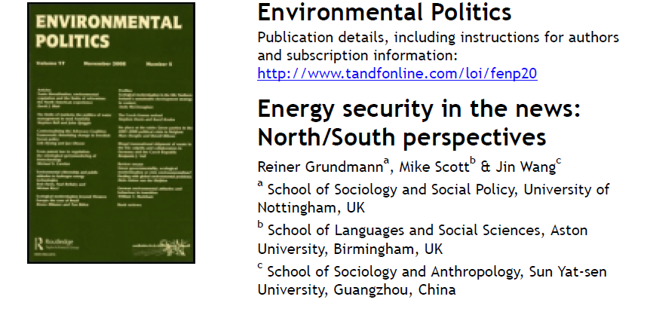

Slide 10
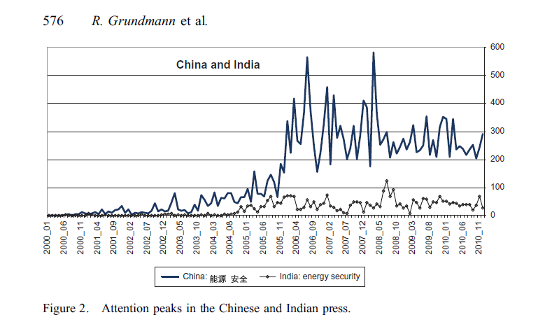

Slide 11
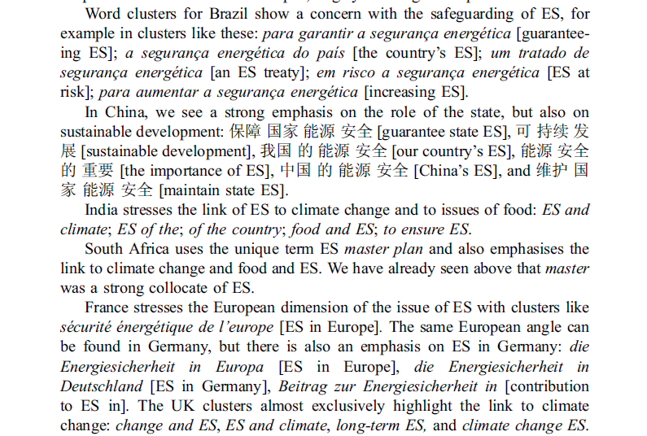

Slide 12
Research Agenda
Make sense of complexity

Slide 13
Kintsch & van Dijk (1970s)
macro-rules
Generalization: use “super-propositions”
Deletion: omit unwanted detail
Construction: use entailment to draw inferences

Slide 14
A Text Linguistic Objective of the 1970s
To come up with a set of macro-propositions which could represent the gist of the text.

Slide 15
Kinstch & van Dijk
macro-rules
Generalization: use “super-propositions”
Deletion: omit unwanted detail
Construction: use entailment to draw inferences

Slide 16
Generalization
“Of a sequence of propositions we may substitute any subsequence by a proposition defining the immediate superconcept of the micropropositions”
Mary was drawing a picture. Sally was jumping rope and Daniel was building something with Lego blocks.
The children were playing.

Slide 17
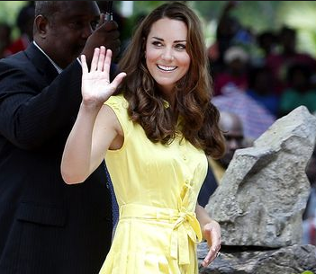
Deletion
“Of a sequence of propositions we may delete all those denoting an accidental property of a discourse referent”
A girl in a yellow dress passed by.
1. A girl passed by. (2. She was wearing a dress. 3. The dress was yellow.)

Slide 18
Construction
“Of a sequence of propositions we may substitute each subsequence by a proposition if they denote normal conditions, components or consequences of the macroproposition substituting them.”
John went to the station. He bought a ticket, started running when he saw what time it was and was forced to conclude that his watch was wrong when he reached the platform.
John missed the train.

Slide 19
Corpus Linguistics
but now in 2016?

Slide 20
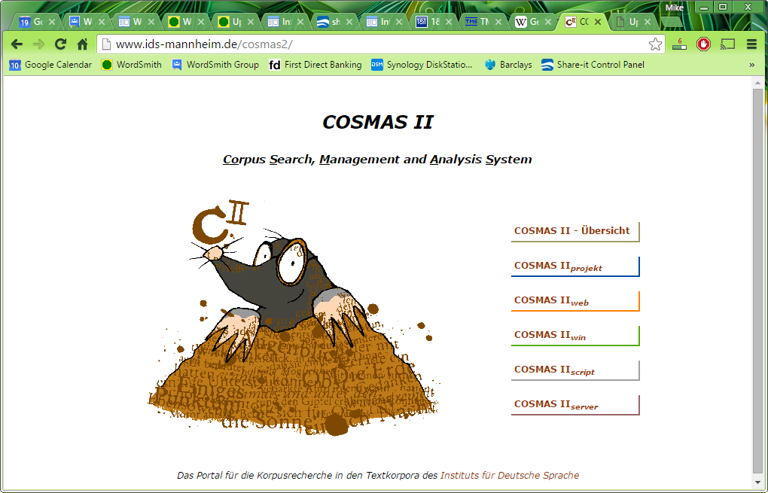
Standard corpora
British National Corpus
Corpus of Contemporary American English (COCA)

Slide 21
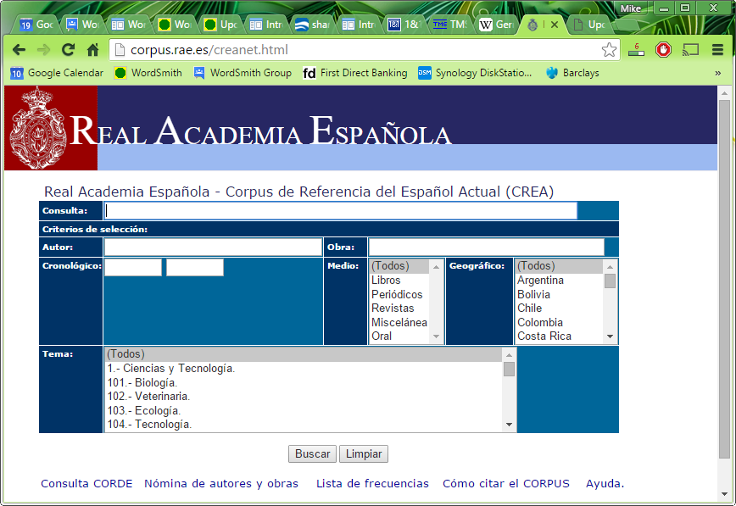

Slide 22
Your own corpus
In contrast to other well-known corpora and corpus archives (such as the British National Corpus), however, the German Reference Corpus is explicitly not designed as a balanced corpus: The distribution of DeReKo texts across time or text types does not match some predefined percentages.
This conception complies with the fact that whether or not a given corpus constitutes a balanced or even representative language sample may only be assessed with respect to a specific language domain (i.e., the statistical population). Because different linguistic investigations generally aim at different language domains, the declared purpose of the German Reference Corpus is to serve as a versatile superordinate sample, or primordial sample (German: Ur-Stichprobe) of contemporary written German, from which corpus users may draw a specialised subsample (a so-called virtual corpus) to represent the language domain they wish to investigate.
(https://en.wikipedia.org/wiki/German_Reference_Corpus#Access, Jan 2016)

Slide 23
Your own texts
From your students
Your research archive
LexisNexis and other standard text collections
Project Gutenberg
Oxford Text Archive

Slide 24
text patterns

Slide 25
Example of corpus

Slide 26
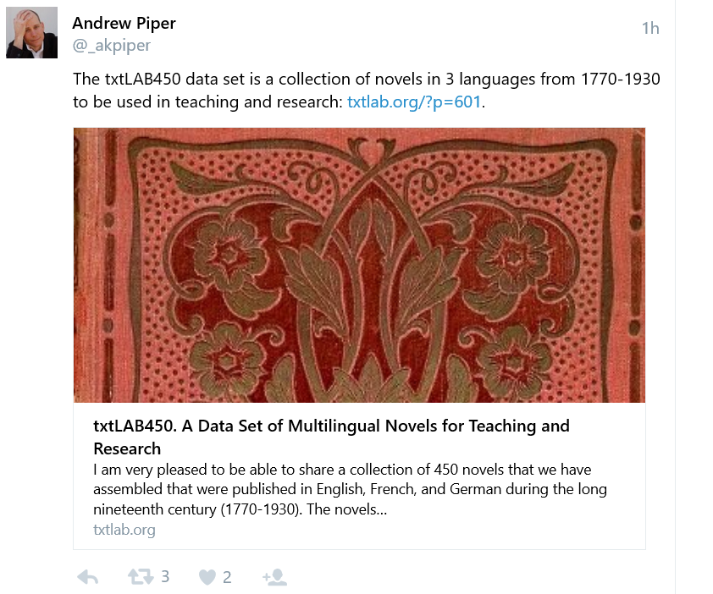
Twitter

Slide 27
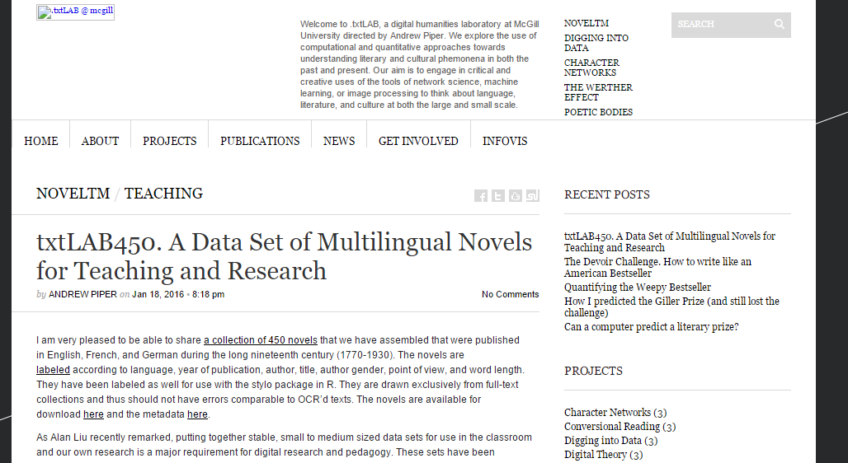
txtLAB450

Slide 28
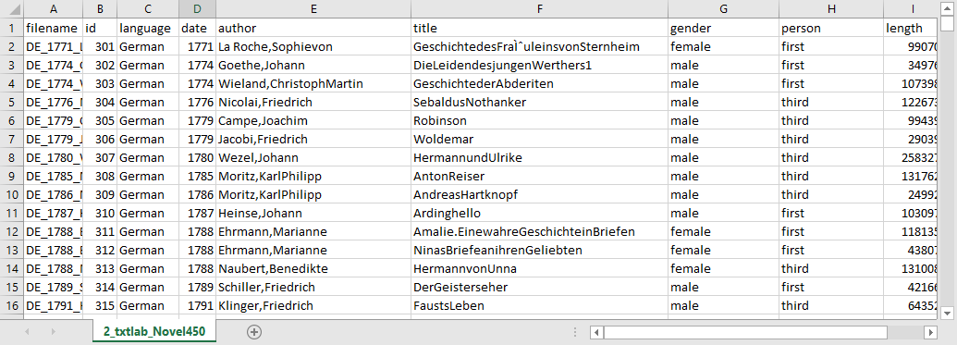
accompanying spreadsheet

Slide 29
Limitations
Corpus tools typically ignore
images
numbers, dates
equations
variations in typeface
hyperlinks
related sound or video files

Slide 30
Problems
Multiple formats
PDF format
One text = one file?
Incomplete texts
Duplicated texts

Slide 31
Formats
ASCII, ANSI (one byte per character)
legacy formats from 1960s to 1990s (DOS, Windows, Mac, IBM etc.)
UTF8 varied bytes per character
UTF16 allows for 65,000 characters, fixed 2-bytes per character

Slide 32
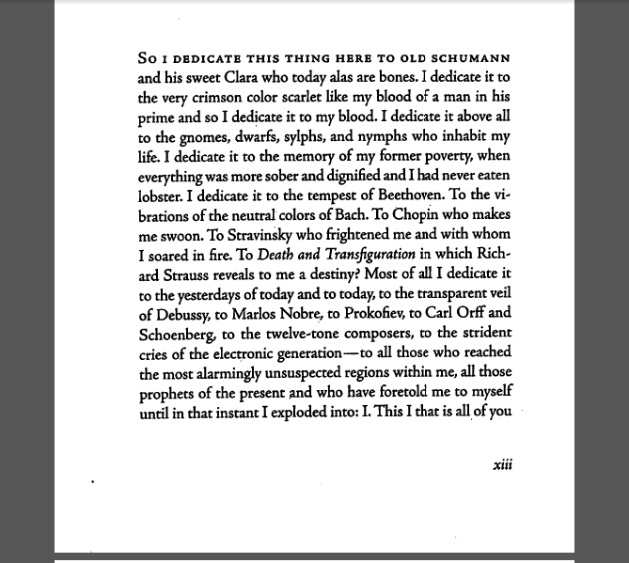
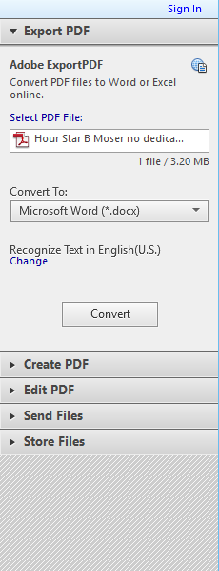
PDF
save as?

Slide 33
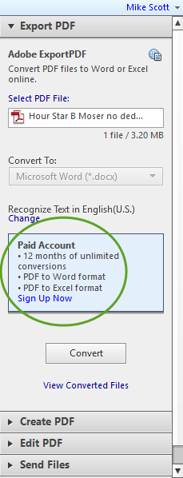
converting PDF to plain text….
Adobe Reader
Save As…
Export as Word .docx

Slide 34
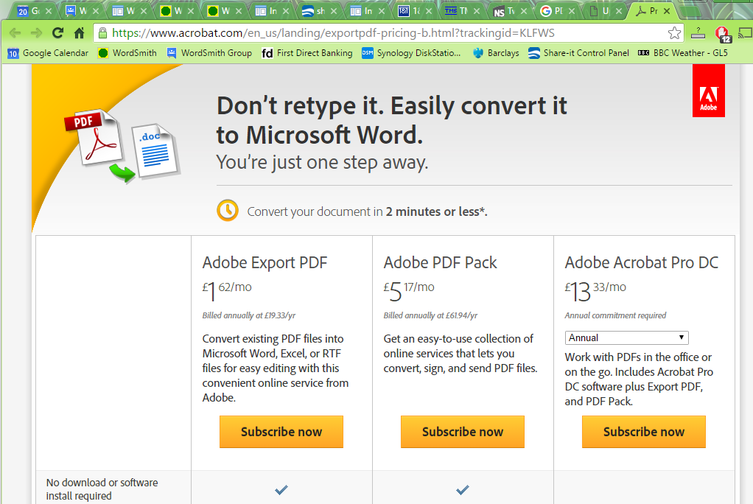

Slide 35
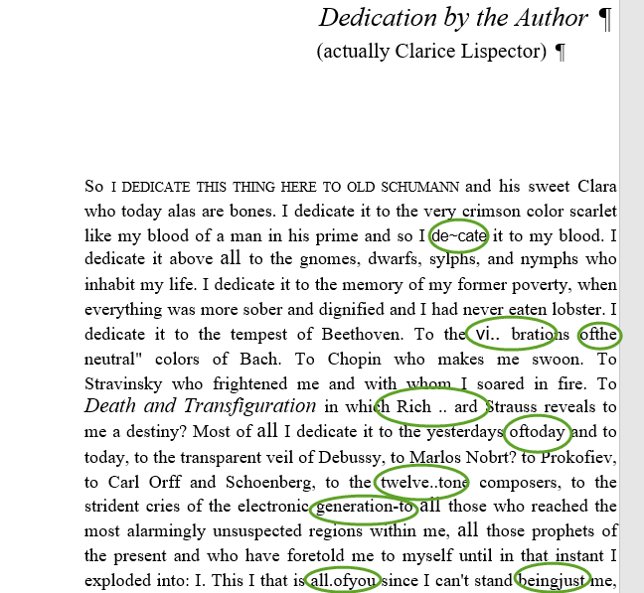
Adobe Acrobat
OCR
Save as .doc

Slide 36
Why Corpus Tools
process larger amounts of text
transform the text in varied ways
seeking patterns

Slide 37
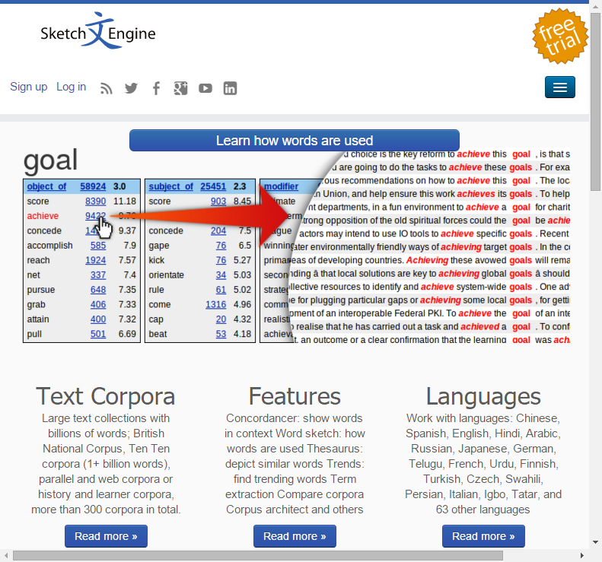
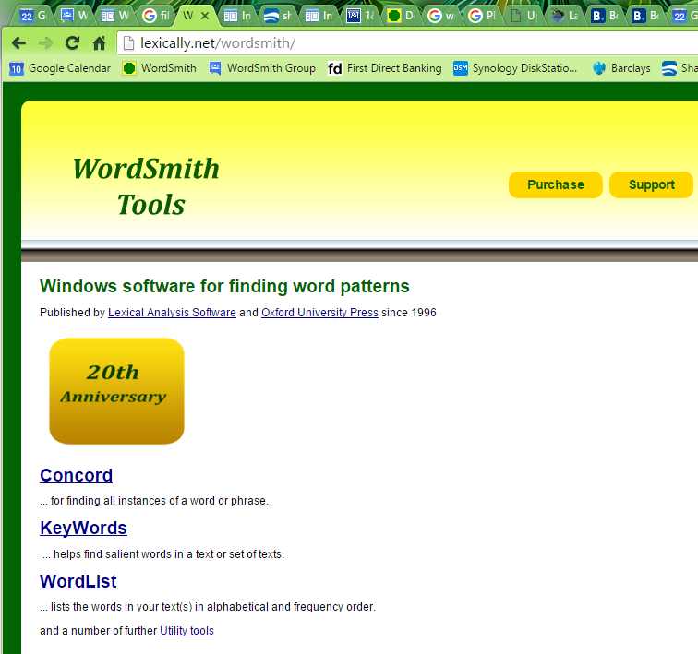
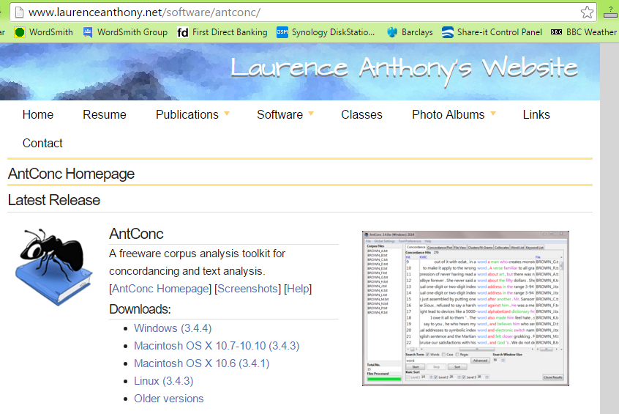
Which Corpus Tools?
online corpus tools
stand-alone
grammar patterns

Slide 38
How
simple word lists
concordances
collocation patterns
dispersion plots

Slide 39
at a basic level…
let you see the overall vocabulary
multiple examples of words & phrases
can be broken down by
number of texts
location in text
context words

Slide 40
dealing with large amounts of data
sorting
filtering out

Slide 41
corpus-based or corpus-driven
corpus-based: uses a corpus to try to find examples of something where the underlying research categories already exist
looking through a large text corpus for references to austerity and seeking collocates

Slide 42
corpus-based or corpus-driven
corpus-driven: explores a corpus trying to find out what is identified as typical or outstanding
looking through a large text corpus concerning austerity, seeking typical key words

Slide 43
Issues
What is the unit of text we are working with?
Can you see the text patterns?

Slide 44
Levels of Context
What is the unit of text we are working with?
single words
n-grams
paragraphs
whole texts
genres

Slide 45
Corpus Linguistics
can operate at any of these levels
and can use comparison

Slide 46
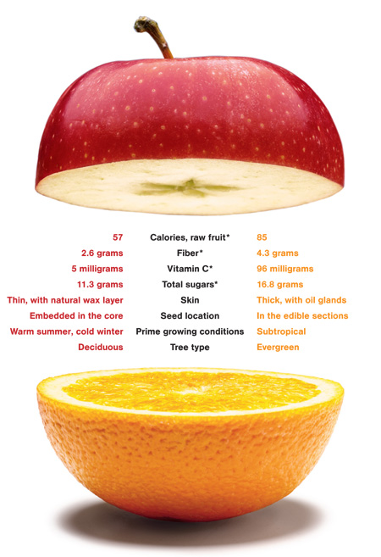
Choice of reference corpus

Slide 47
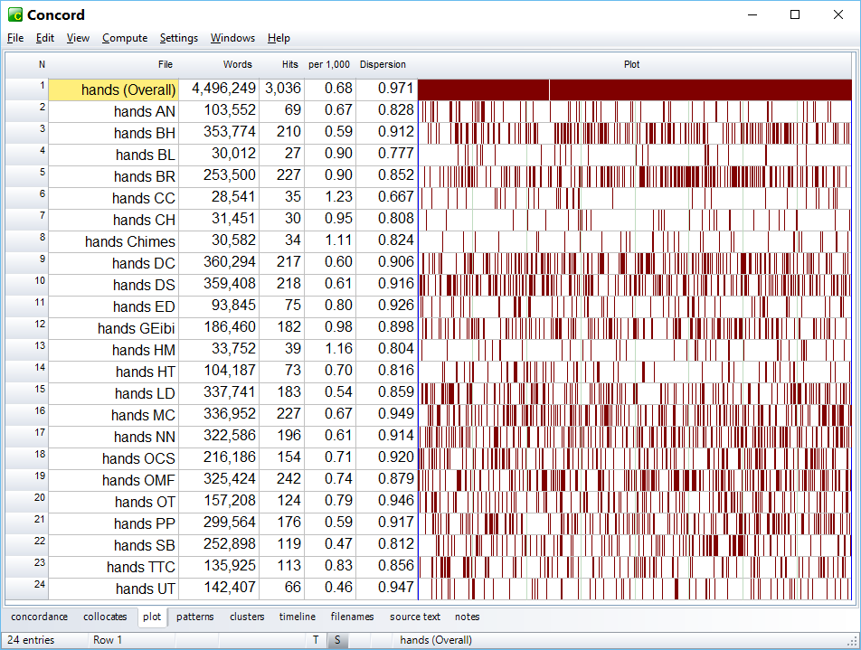
Finding patterns

Slide 48
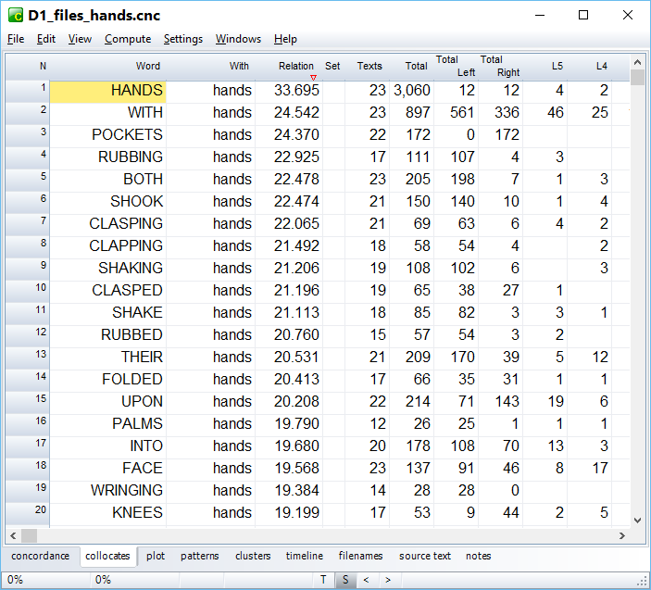

Slide 49
Conclusions
Corpus Linguistics tools:
relevant to the Social Scientist
traditional tools to be retained
limitations
do not give answers but pointers

